Slide 1
Slides are mainly from the Honeypot Project

Slide 2
What Are Honeypots
A security resource who’s value lies in the unauthorized or malicious interaction with it.

Slide 3
Why Honeypots
A great deal of the security profession (and the IT world) depend honeypots, however few know it. Honeypots …
  Build anti-virus signatures.
  Intelligence gathering (Symantec / Arbor)
  Build SPAM signatures and filters.
  Build RBL’s for malicious websites.
  ISP’s identify compromised systems.
  Assist law-enforcement to track criminals.
  Hunt and shutdown botnets.
  Malware collection and analysis.

Slide 4
Their Value
Primary value of honeypots is to collect information.
This information is then used to better identify, understand and protect against threats.
Honeypots add little direct value to protecting your network.

Slide 5
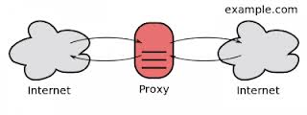
Different Types
Server: Put the honeypot on the Internet and let the bad guys come to you.
Client: Honeypot initiates and interacts with servers
Other: Proxies (monitor spamming behaviors)

Slide 6
Low vs High Interaction
The amount of activity a threat can have with a honeypot.
Low-interaction emulates, high-interaction is the real thing.
Neither solution is better, depends on what you want to achieve.

Slide 7
Low-Interaction Server
Software that emulates functionality. Easier to deploy and automate, less risk, but customized to more specific attacks.
  Nepenthes
  Honeyd
  Honeytrap
  Web Applications
  KFSensor

Slide 8
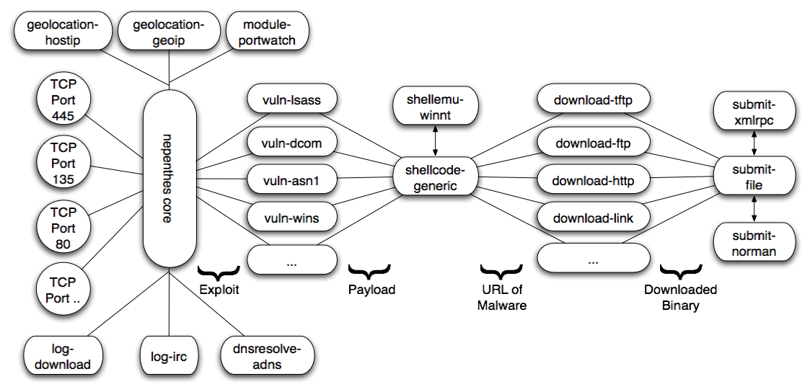
Nepenthes

Slide 9
Value: Malware Collection & Botnet Monitoring
Nepenthes retrieves malware following a successful attack.
Malware designed to join command channel for remote control.
Use same information, join with botnet monitoring software.

Slide 10
High-Interaction Servers
Typically real applications on real systems. Much more manual work, but more flexible in the data and threats it can capture.

Slide 11
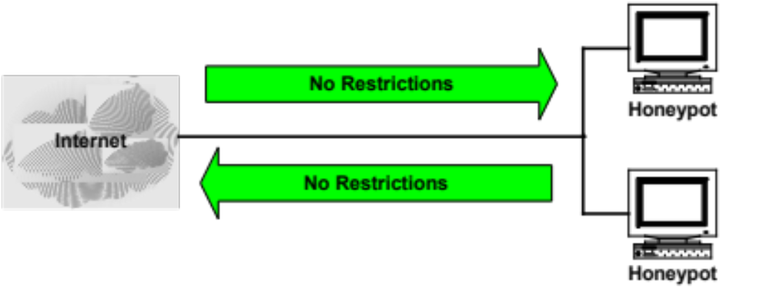
No Data Control

Slide 12
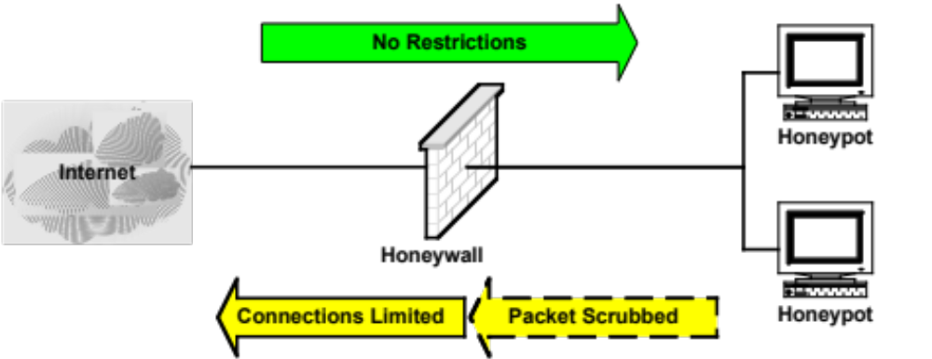
Data Control

Slide 13
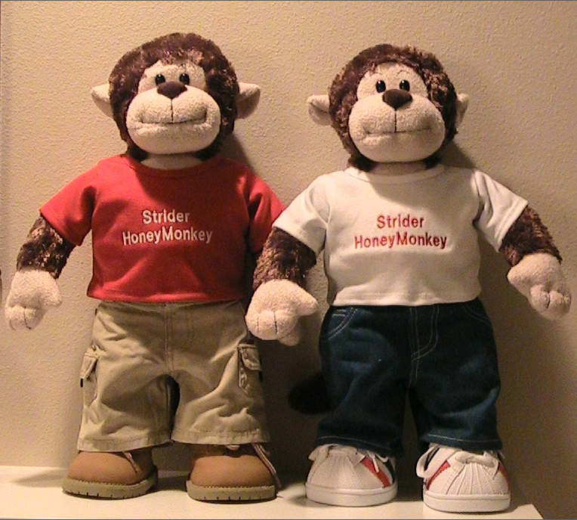
Client Based Honeypots
Threats change, and so to do the technologies. Bad guys have moved to client based attacks, they let the victims come to them.
  Capture-HPC (high interaction)
  HoneyC (low interaction)
  Microsoft Strider Honeymonkey

Slide 14
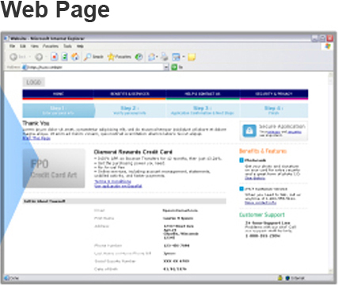
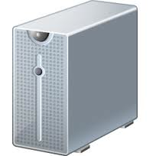






landing page
www.lp.com/page.php
…
HTTP Response
Advertisement content
www.fifth.com/t.php
…
www.rs.com/go.js
Redirection Server
www.exploit.com/hack.exe
…
Exploit Server

Slide 15
Existing Detection Methods
Internet
Benign
……
……
……
……
Client Honeypot
Malicious
……
……
……

